Slide 1





Data Insights Overview
Data driven analysis for operational efficiency and sales optimization.
Presented by:
Pranit Gore

Slide 2

Three Generations Of Service
Seema Scientific was established in 1996 and is proudly serving scientific and chemical apparatus to 200+ institutions with a 5 star customer satisfaction rating on Justdial.
ABOUT SEEMA SCIENTIFIC
Four Pillars of Service
Seema Scientific has a reputation of providing high-quality, certified materials along with their tailored service of packaging and lab setups customized as per curriculum, and specific needs.
Board Wise Supply
Seema Scientific provided curriculum based materials for SSC, CBSE, HSC, CISCE, IGCSE and IB, with the complete catalogue available on their website.

Slide 3
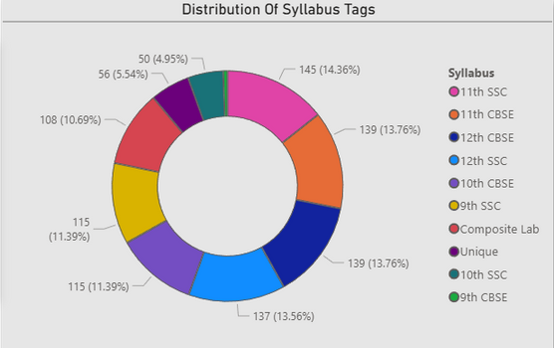
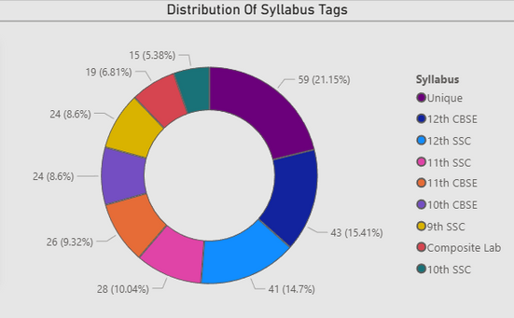
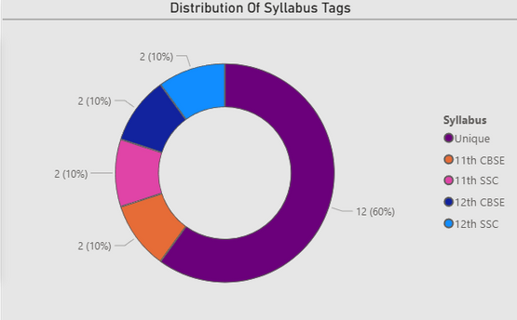
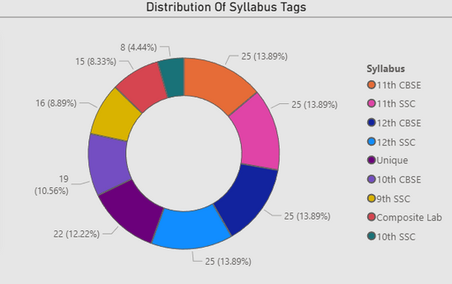
Glassware
Physics
Data Summary
Maths
Instruments
The chart illustrates the distribution of requirements based on each syllabus category, for each curriculum, reflecting shifting consumer preferences and successful marketing strategies.
COMPARING 10 SYLLABUS CURRICULUMS OVER REQUIREMENTS

Slide 4
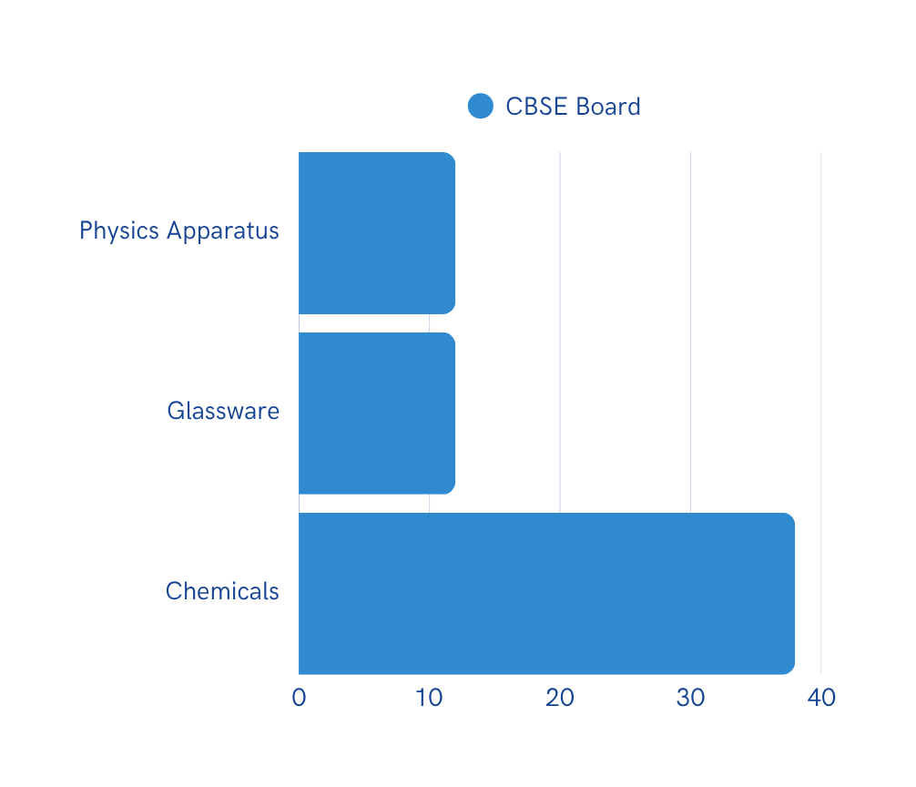
Yearly Customer Acquisition
The chart illustrates significant growth in customer acquisition over the past five years, for CBSE. Chemicals show a steady increase, while Glassware and Physics Apparatus experienced a notable spike in 2024.
ANNUAL CUSTOMER GROWTH TRENDS ACROSS THREE DIFFERENT CATEGORIES

Slide 5
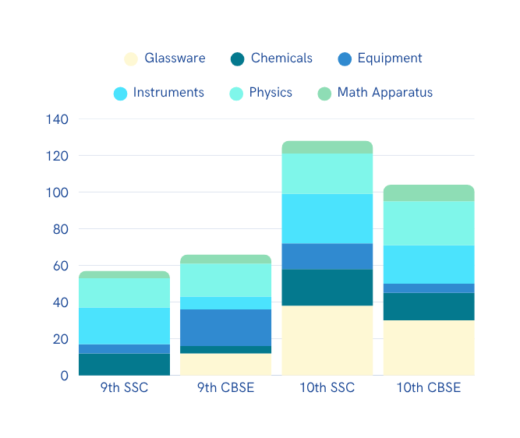
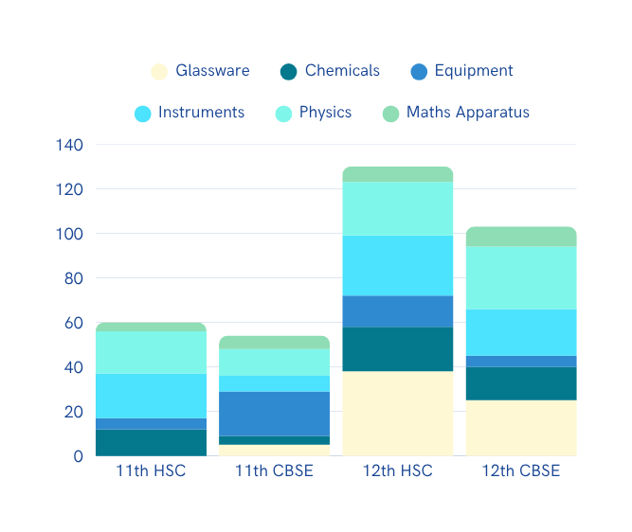
Market Sales Comparison Over Time
The chart illustrates the contribution of sale of categories for each curriculum, depicting most sold items, and least sold items, reflecting prioritization of these products for B2B Sales.
ANALYZING TRENDS ACROSS MOST SOLD ITEMS IN EACH CURRICULUM OVER TIME

Slide 6
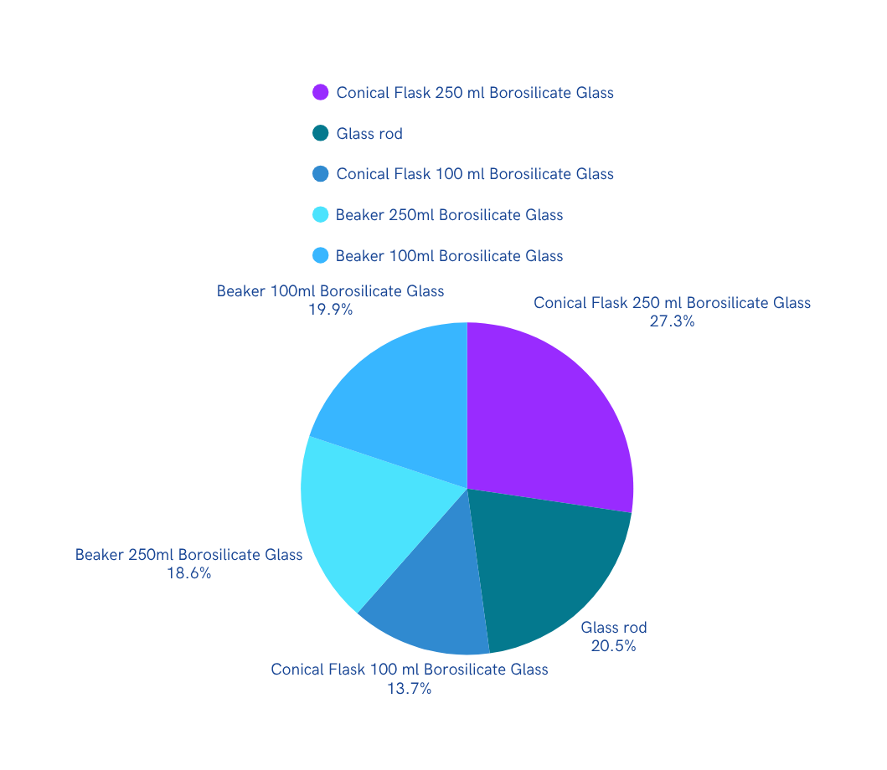
Glassware
MOST SOLD ITEMS -1
The chart illustrates the most sold items for each category, reflecting prioritization of respective items in B2B sales and successful marketing strategies.
MOST SOLD ITEMS OF GLASSWARE

Slide 7
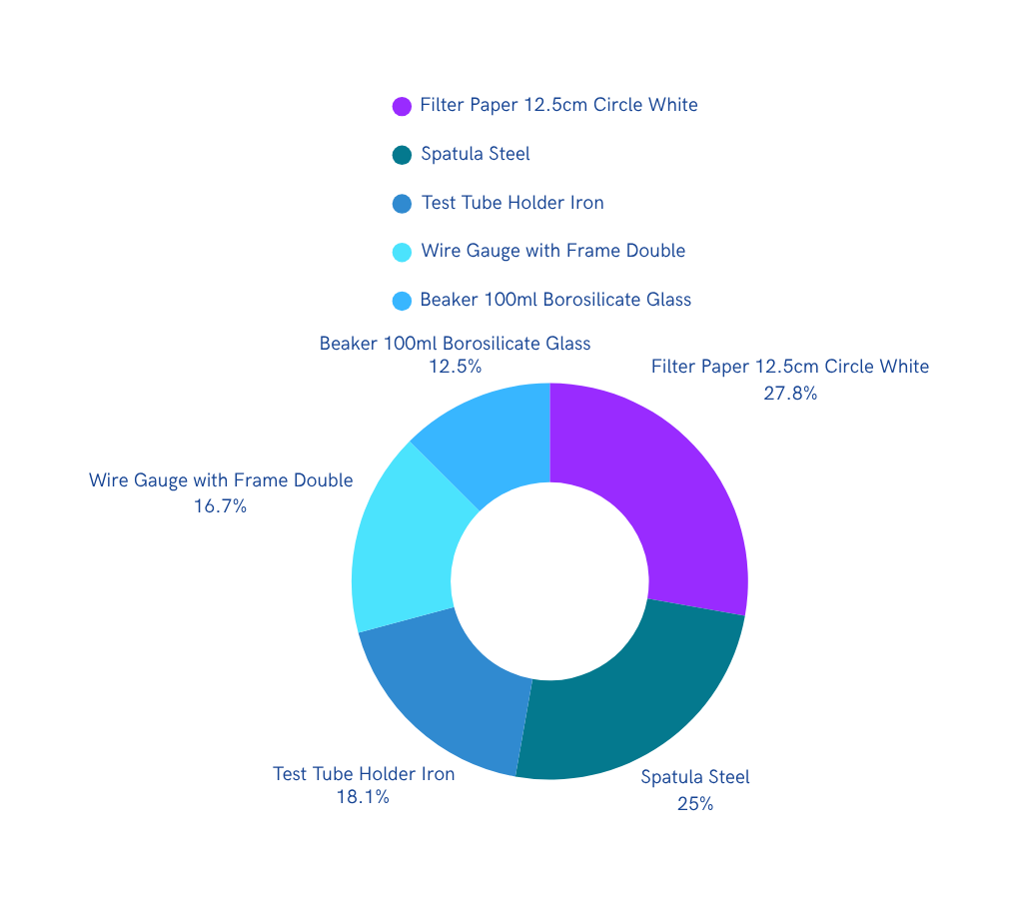
Equipments
MOST SOLD ITEMS- 2
The chart illustrates the most sold items for each category, reflecting prioritization of respective items in B2B sales and successful marketing strategies.
MOST SOLD ITEMS OF EQUIPMENTS

Slide 8
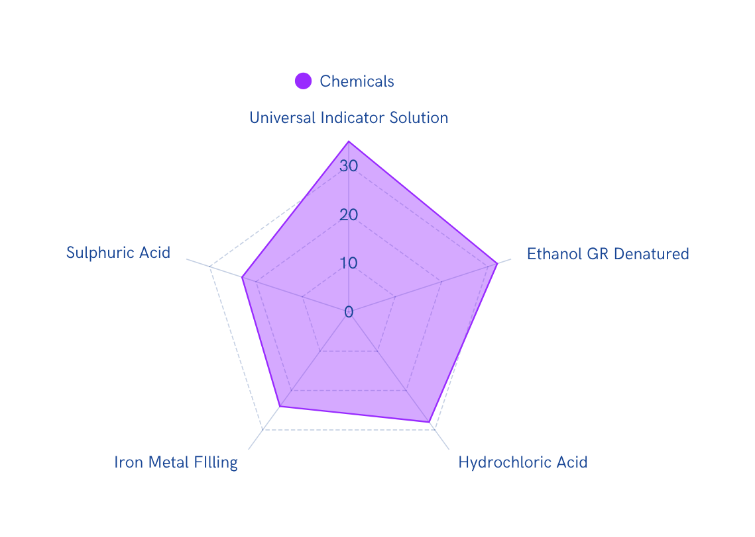
CHEMICALS
MOST SOLD ITEMS- 3
The chart illustrates the most sold items for each category, reflecting prioritization of respective items in B2B sales and successful marketing strategies.
MOST SOLD ITEMS OF CHEMICALS

Slide 9
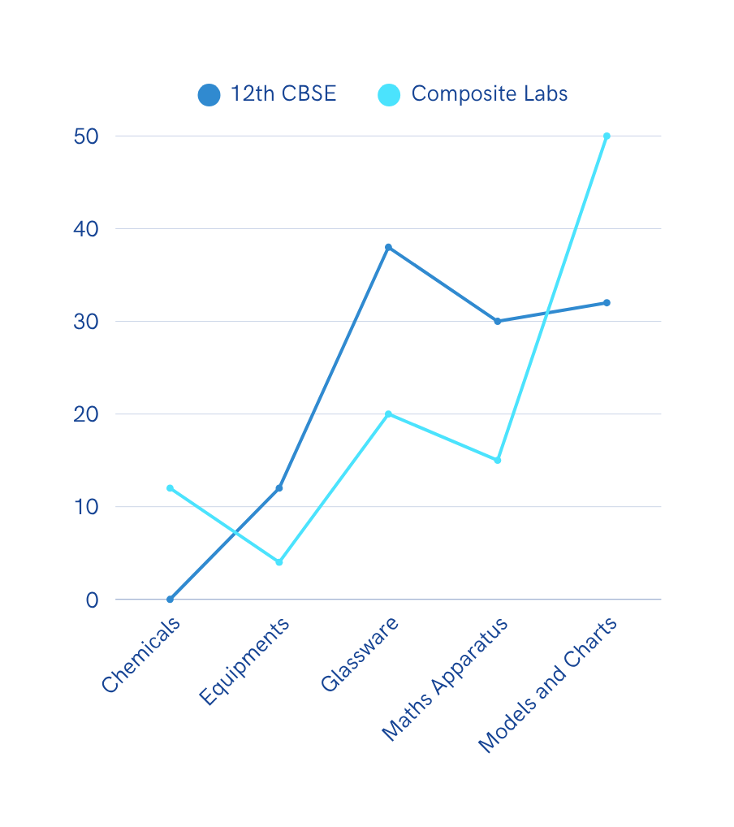
Sales by Product Line
The chart reveals a steady growth in 12th CBSE sales, while Composite Labs shows fluctuations. This indicates a potential shift in consumer preferences and market trends that warrants further investigation.
MONTHLY SALES COMPARISON OF TWO CURRICULUMS OVER THE YEAR

Slide 10
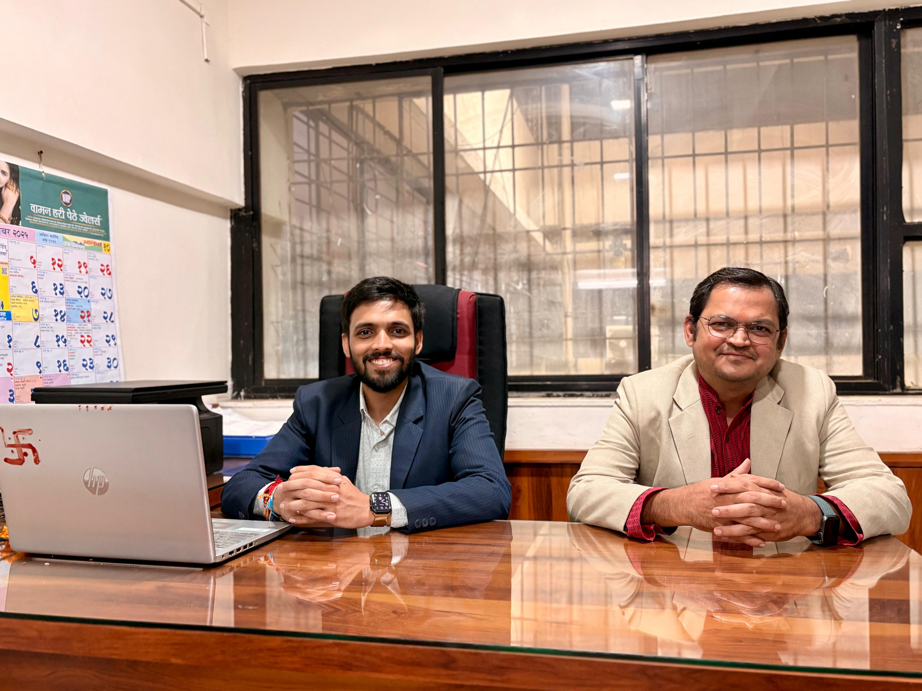

Contact Us Today
Website
seemascientific.com
Email
seemascientific@gmail.com

Slide 11

About Me
Computer Engineering Student passionate about Data Science. I am a researcher and a UK Patent Holder with a strong interest in Biomedical AI.
Email
pranitgore05@gmail.com
Contact Me
+91 8999290255

